Slide 1

Microsoft Power BI
From data to insights within minutes

Slide 2





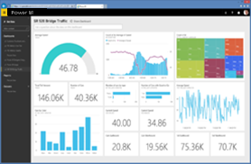

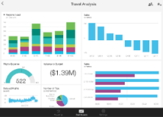
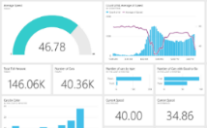



Why Power BI?
Power BI transforms your unrelated on-premise and cloud data sources into coherent, visually stunning and securely share interactive insights
Power BI
Consolidate multiple sources into one place
Transforming data into a data model to get insights
Create rich-interactive visualizations with AI infused analytics
Notes:
API: researchers uses lots of external sources that provides API access nowadays like SSB (Statistik sentralbyrå), BRREG (Brønnøysundregistrene), etc
R or Python: researchers are familiar with R. They can run R script to import data, transform data or create visualizations in PBI Desktop
Power BI supports both on premises and cloud data sources. There are more than 135 native data connectors. You can also write your custom connector for your data source.
Work with multiple sources , transforming data and merging them into a data model to get insights.
Include AI and ML capability like embedding R or Python scripts even a natural language query where PBI will display adhoc visuals base on user’s input/question.
Transforming towards self-service platform where users can build their own report based on certified dataset

Slide 3
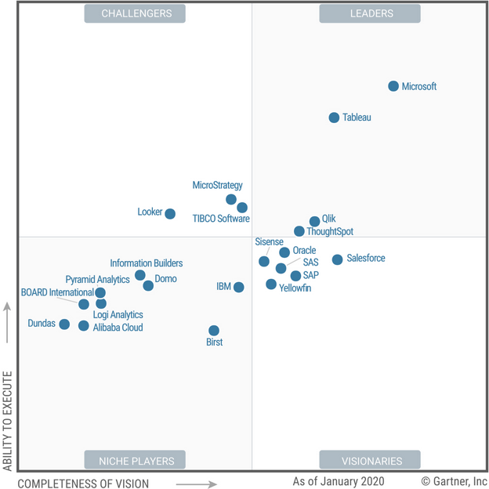
Why Power BI?
In February 2020, Gartner recognizes Microsoft Power BI for the 13th consecutive year as the leading and most visionary platform in business intelligence and analytics.
Monthly updates and product enhancement with active end-users and developer forum.
Notes:
On top of that, it is important that Power BI has been recognized for 13th consecutive year by Gartner as the leader in the Magic Quadrant for Analytics and Business Intelligence Platforms.
PBI continue to outperform its competitor with frequent updates that are packed with innovative features.

Slide 4

Power BI Overview
Power BI Desktop
Power BI Service
Data sources
Organization Apps
Sharing & collaboration
SaaS solutions
Salesforce, Google Analytics
Live dashboards
On-premises data
SQL Server, SAP HANA
Visualizations
IT Operations SCOM, Log Analytics, Teams Usage
Natural language query
Azure services
Azure SQL, Stream Analytic
01001
10101
Excel files
Workbook data / data models
Datasets
Source: Microsoft
Data refresh
Notes:
A good overview of PBI in practice.
Separate into 2 main environment:
Desktop where most development take place. Consider as part of the back-end of the platform. The whole ETL process where you extract the data, transform them into related information and analyze them accordingly. Goal is to create a meaningful set of data for development and analysis by end user.
Service where you publish and collaborate with users. This is the front-end of the platform where users consume and interact with the end products.
Content packs are pre-built apps by popular SaaS (Software as a Service) provider like Salesforce, Quickbook, Dynamic 365 and more…
Real-time data streaming from IoTs

Slide 5
Power BI Licensing
Power BI Desktop
Free download tool where most development take place.
Power BI Free
Online self-service analytics for personal use only.
Power BI Pro
Licensed per user online self-service for collaboration and sharing reports via Teams, Sharepoint, etc. Included in Office 365 E5/A5 plan.
Power BI Premium
Licensed by capacity for large scale BI platform where contents can be shared and consumed by non-licensed users.

Slide 6


Free vs Pro License
 | Free | Pro
Schedule Auto Refresh of Dataset | 1/day | 8/day
Publish to Web (Not Secure) | P | P
App Workspace |  | P
Teams Full Integration |  | P
Sharepoint Embedding / OneDrive Integration |  | P
Organizational/Marketplace Apps (M365 Usage Metrics, SCOM) |  | P
Dataflow and/or Certified Dataset |  | P
Row Level Security by Group/Department/Region |  | P
Report and/or Apps Template (Standard for User/Team/Region) |  | P
Report/Dashboard Subscription |  | P
Analyze in Excel |  | P
Notes:
App Workspace: Free only have its own My Workspace (10Gb), cant share, create or access other workspaces. Pro users can access workspaces, each workspaces have 10Gb storage limit, so its 10Gb x number of Pro licenses per tenant
OneDrive: Collection of files like Excel or CSV dump in folders, report updates every hour automatically
Organizational Apps: Usage Metrics for IT Ops
Certified Dataset: Label the dataset as Confidential
Subscription: Useful for mgmt to get periodic email of updated reports/dashboard
Analyze in Excel: users that are comfy with Excel can connect the dataset and run Pivot tables, etc
Using Templates to Speed Up and Standardize Report Development
Building new reports from scratch can be time-consuming and enforcing standards on those reports can be extremely difficult. The use of Power BI templates (.pbit files) can speed up report development significantly and improve standardization across reports.
Instead of starting with an empty .pbix file, templates allow report creators to create a new file with:
• A corporate color scheme already in place (it is also possible to store a color scheme as a Report Theme which can be imported into Power BI Desktop).
• Corporate branding already applied to pages.
• Connections to commonly used data sources already created.
• Parameterized queries connected to a data source. This is particularly powerful because it allows your users to reuse queries that someone else has created yet customize the way these queries behave. For example, you can have a parameterized query that applies a date filter to a large table so only rows that fall in each date range are imported. When a user opens a template containing the parameterized query, they are prompted to enter the date range for the data they wish to import.
• Commonly used DAX measures already created inside the dataset.
• Sample visuals which employ data visualization and accessibility best practices.

Slide 7
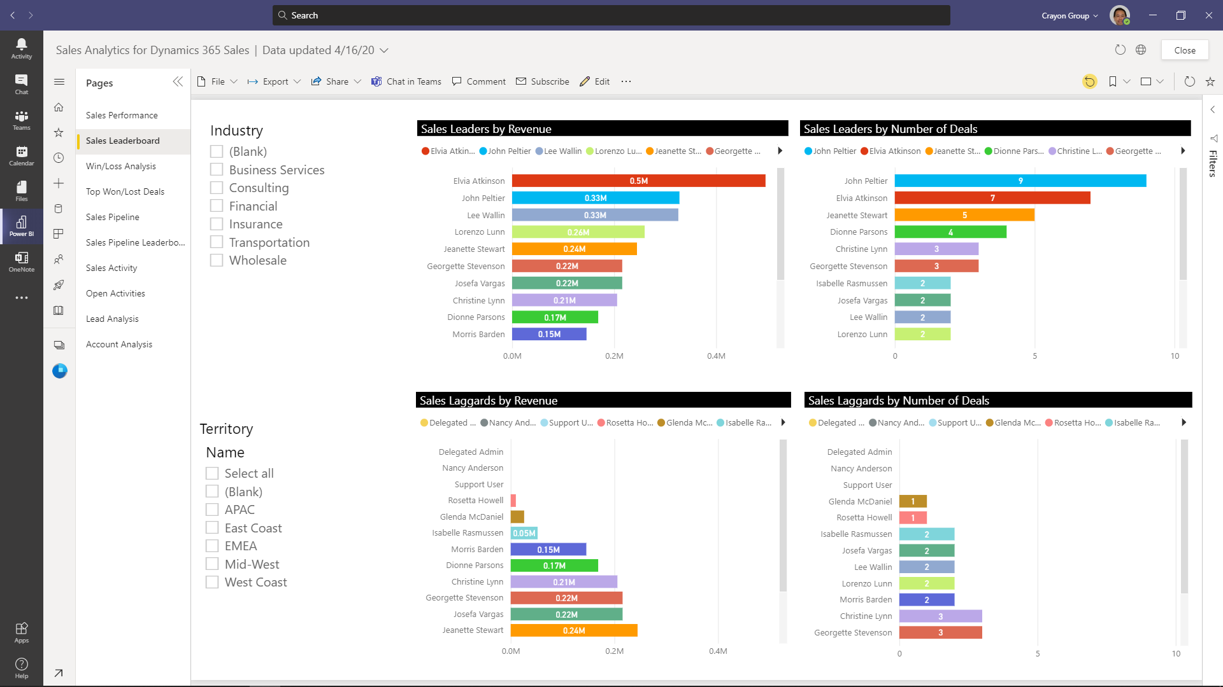
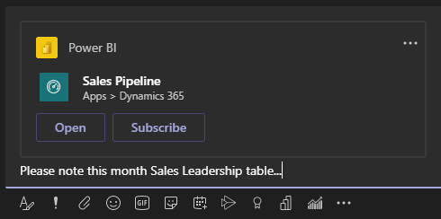
Teams Full Integration

Slide 8
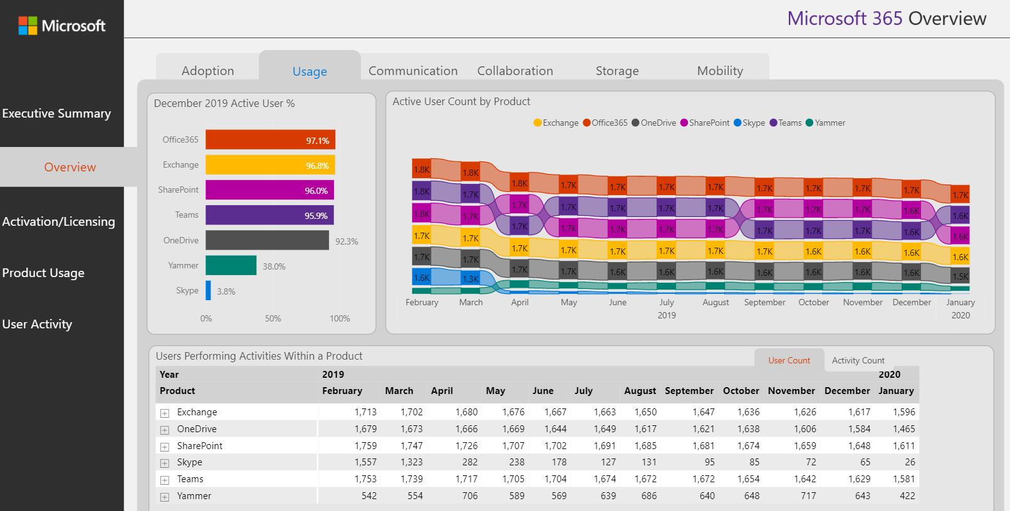
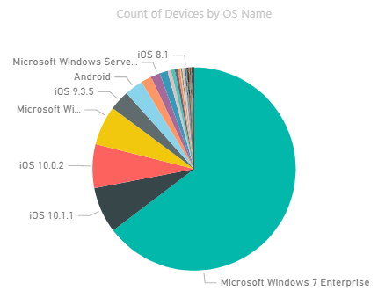
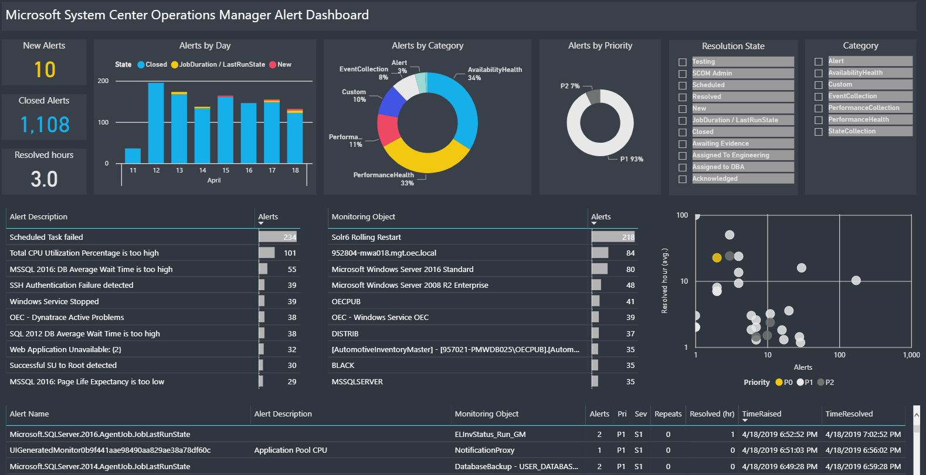
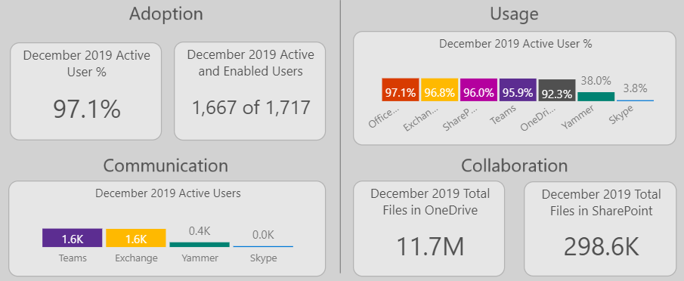
M365 Usage Metrics, SCOM, SCCM
Notes:
SCOM: System Center Operation Manager
SCCM: System Center Configuration Manager

Slide 9
Row Level Security
Team/Department
Region
West
East
R&D
Tech
Region Officer
Energy
Health
Research Officer
End User
Notes:
CRO: Chief Research Officer

